Slide 1


Week 8: Resonance and epistemic access
Ryan Ka Yau Lai
University of California, Santa Barbara

Slide 2


While we’re waiting …
Open SBC007 on Rezonator
Preferably a previously saved version
Choose left-justified grid view
Choose rez mode
Note today’s codeword and question on the board
Sit with your group members
Shameless plug: You can still enroll in LING 194 Visualising language in conversational interactions, which I teach in summer!
Apply for a scholarship here: https://ucsb.my.site.com/success/s/apply-for-summer-scholarship

Slide 3

Question for today
Find one example of any adjacency pair from SBC007 and describe, using syntactic, prosodic and/or pragmatic cues, whether the two people have differential epistemic authority on the subject.

Slide 4
In this class, you will …
Practise
Practise annotating resonance in SBC007 and justifying your response
Navigate
Navigate between groups of resonances in Rezonator using the clique stackings
Understand
Understand the idea of epistemic access and epistemic stance
Identify
Identify linguistic evidence for degree of epistemic authority
Point out
Point out how epistemic stance is taken and negotiated through language in different adjacency pair types

Slide 5
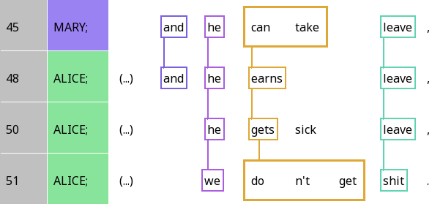
Frame resonance and focal resonance
Question: Which of the resonances between the third and fourth lines are frame resonances? Which are focal resonances? How does your answer differ from the relationships between the first three lines?

Slide 6
Frame resonance and focal resonance
Frame resonance
Focal resonance
Question: Which of the resonances between the third and fourth lines are frame resonances? Which are focal resonances? How does your answer differ from the relationships between the first three lines?

Slide 7
Diagraph
 | A | B | C | D | E
Mary | and | he | can take |  | leave
Alice | and | he | earns |  | leave
Alice |  | he | gets | sick | leave
Alice |  | we | don’t get |  | shit

Slide 8
Analysing analogies in focal resonance
 | B | C | E | C – interpretation
Mary | he | can take | leave | can – Possibility
Alice | he | earns | leave | -s – Habit
Alice | he | gets | leave | -s – Habit
Alice | we | don’t get | shit | don’t - Impossibility

Slide 9
Analysing analogies in focal resonance
 | B | C | E | E – interpretation
Mary | he | can take | leave | specific thing
Alice | he | earns | leave | specific thing
Alice | he | gets | leave | specific thing
Alice | we | don’t get | shit | anything

Slide 10
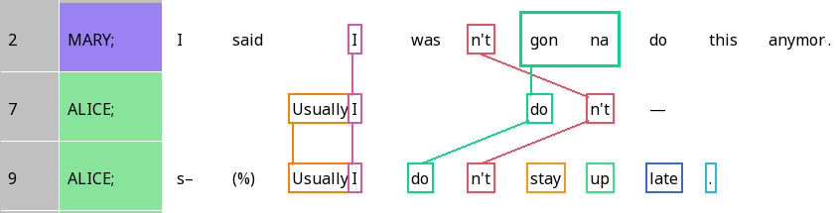
False starts in self-initiated repair
Self-resonance: Repeating structure to complete what you just said

Slide 11
Crossed resonance
When the order of resonating elements is different across different lines
Question: Can you think of a type of adjacency pair where crossed resonance would be common in English?

Slide 12
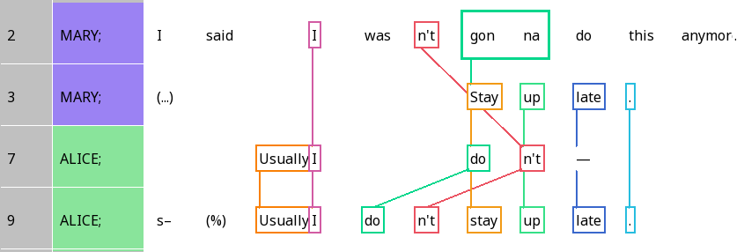
You can resonate with material from different lines!

Slide 13
Let’s have some practice!

Slide 14
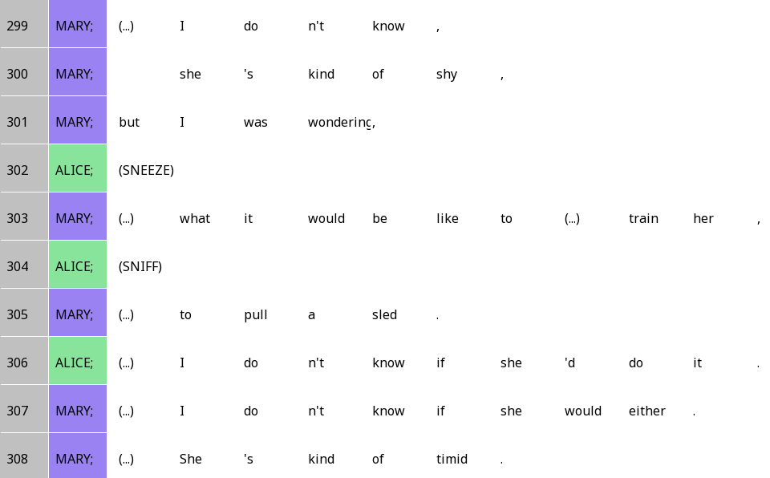
She’s kinda shy (lines 299-308)

Slide 15
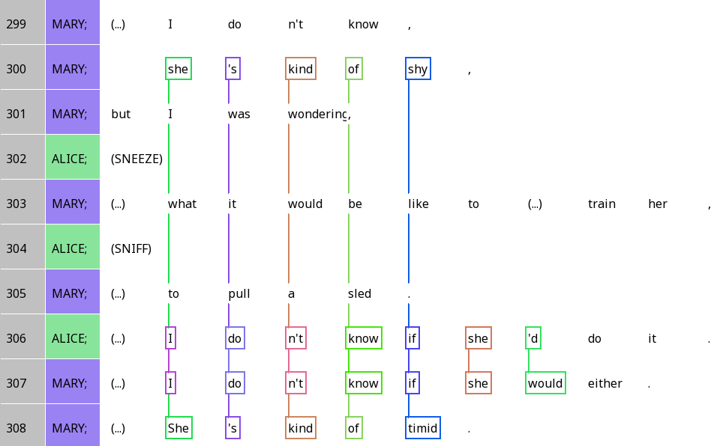
She’s kinda shy

Slide 16
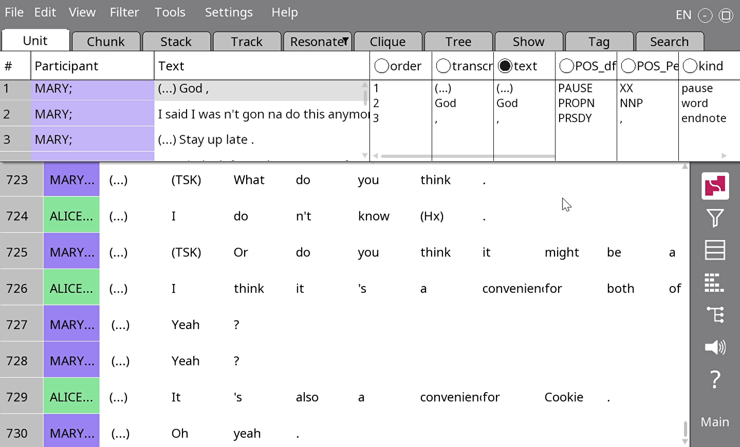
When words go offscreen
Use Settings > Narrow (or ctrl + -) to make the columns narrower
Use arrow keys to scroll horizontally

Slide 17
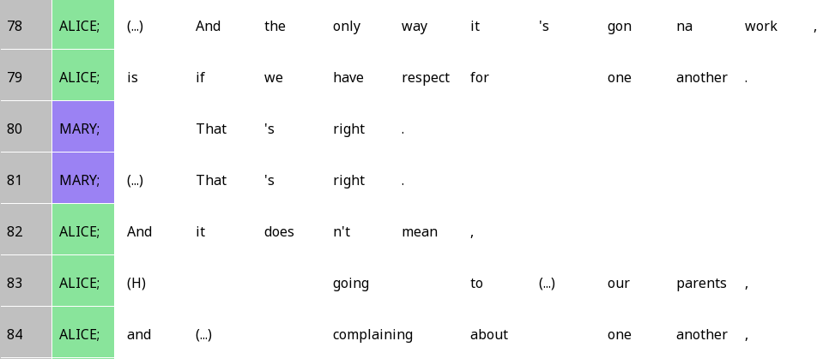
The only way it’s gonna work (lines 78-84)

Slide 18
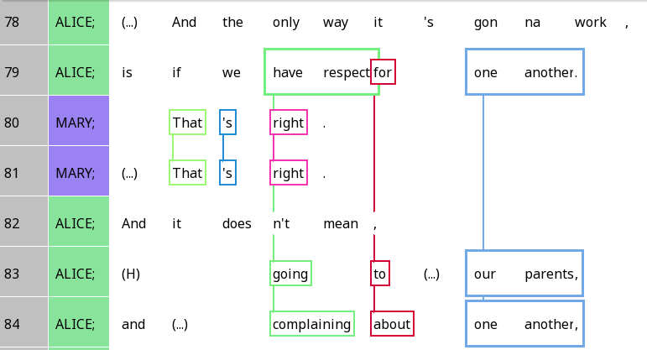
The only way it’s gonna work

Slide 19
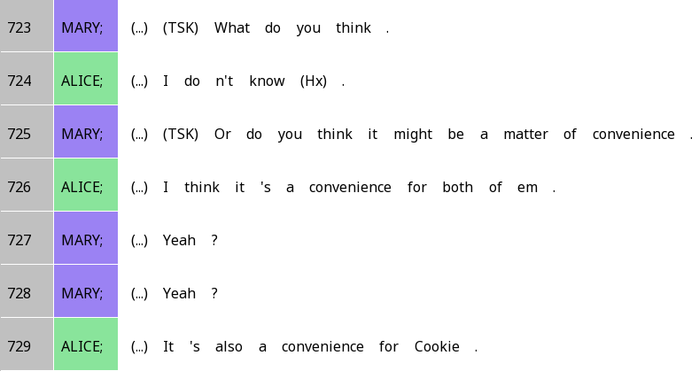
A matter of convenience

Slide 20
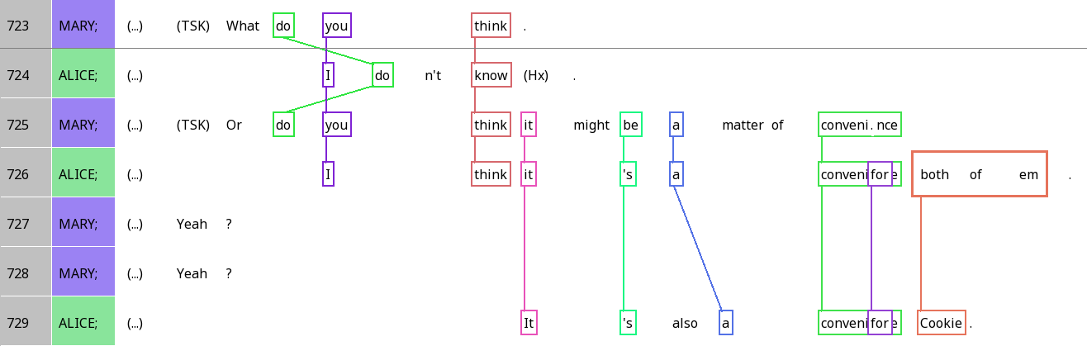
A matter of convenience

Slide 21

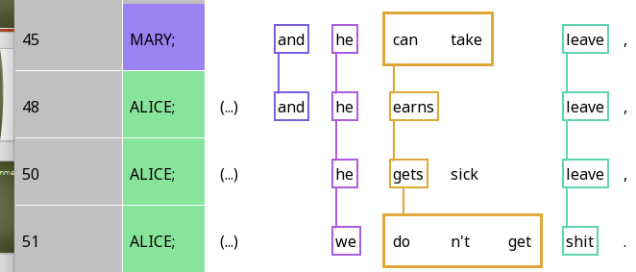
Cliques
A group of interlinked units

Slide 22
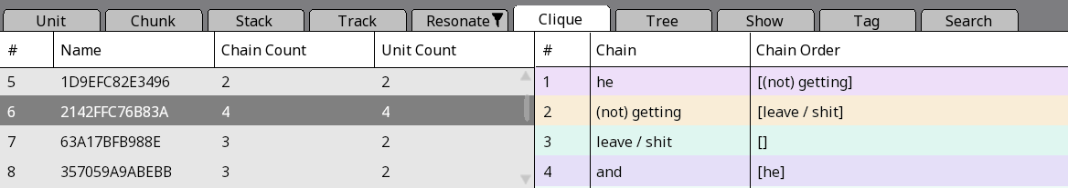
The clique pane
Number of resonances
Number of units
Specific resonance chain
Which chains can follow the present one?

Slide 23
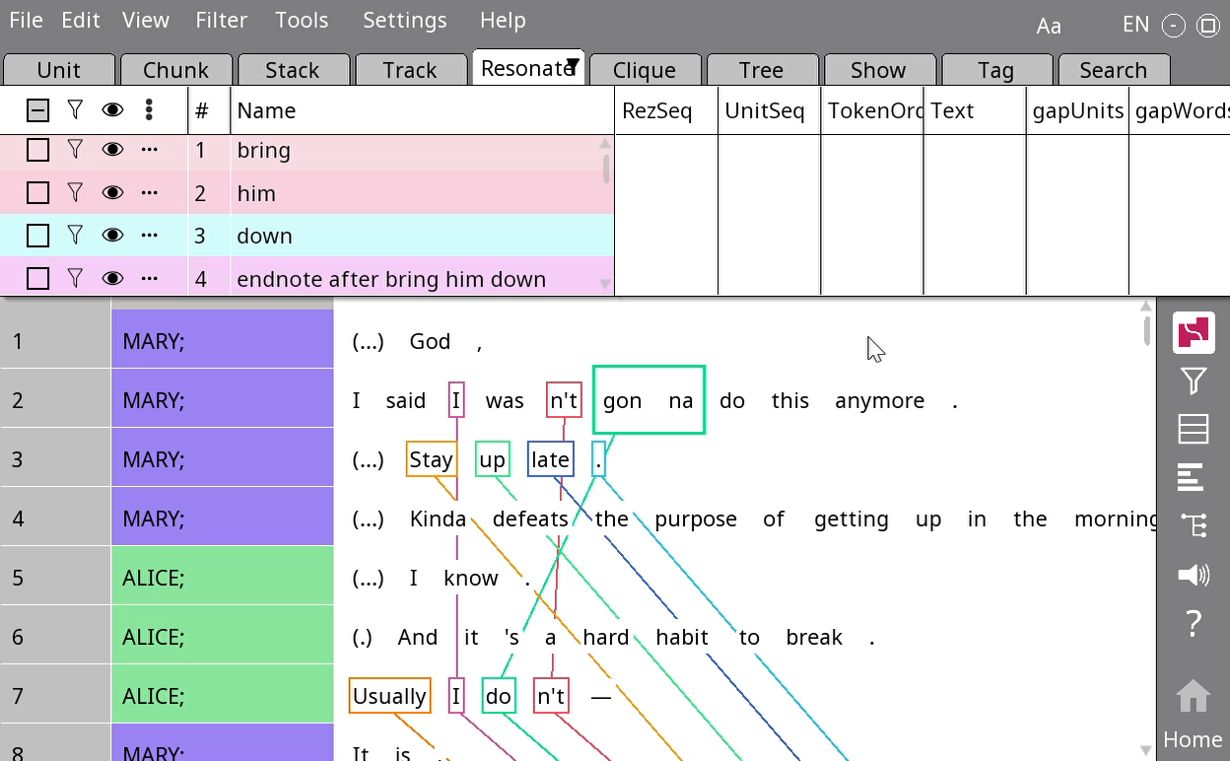
The clique stacker
Go to Tools > Stacker > Clique
Press OK

Slide 24
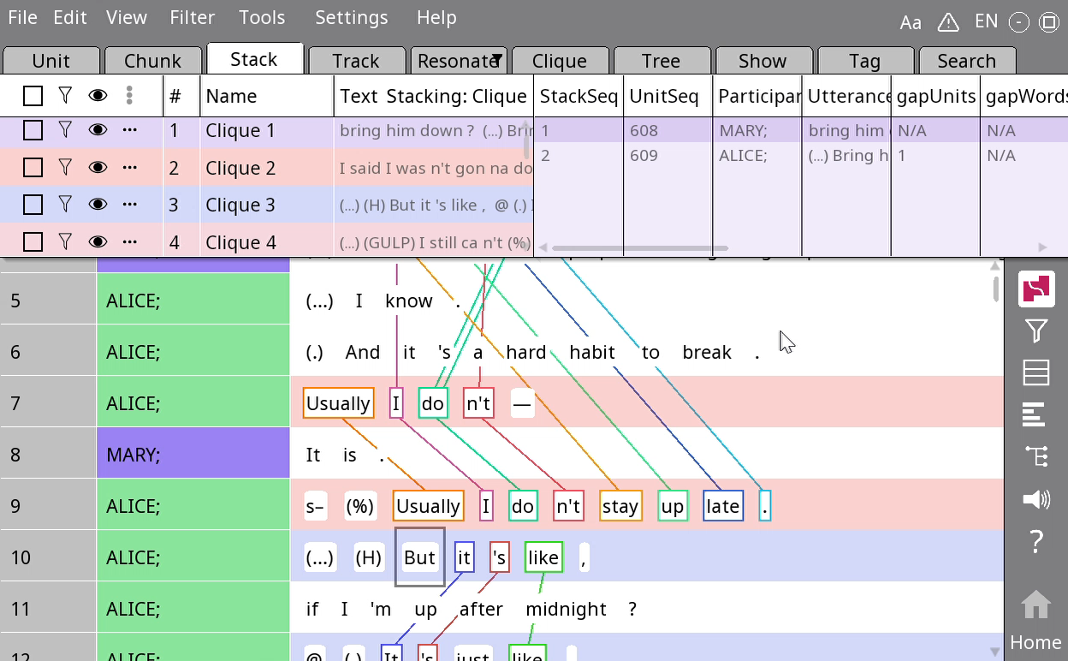
Going through the clique stacking
Right-click on a clique > Rename
Type in a new name > Press OK
You now have an easy way to navigate between cliques!

Slide 25
Epistemic access
Epistemic access: Who knows their stuff more about something
Epistemic stance: How do people portray their and others’ epistemic stance?

Slide 26
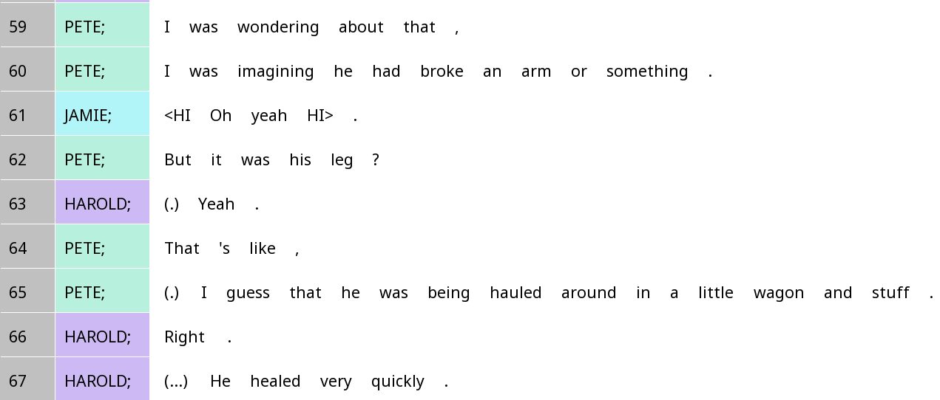
Who ‘knows their stuff’ more about the incident? How can you tell?

Slide 27
Epistemic access and question-answer pairs
Generally: The person who is being asked something has more privileged epistemic access (i.e. should know their stuff more) about the thing being asked about
By asking a question, we usually take an epistemic stance that we know less about something
When Prof Du Bois asks you a question in class, what is the epistemic stance taken? What is the actual epistemic access like?

Slide 28
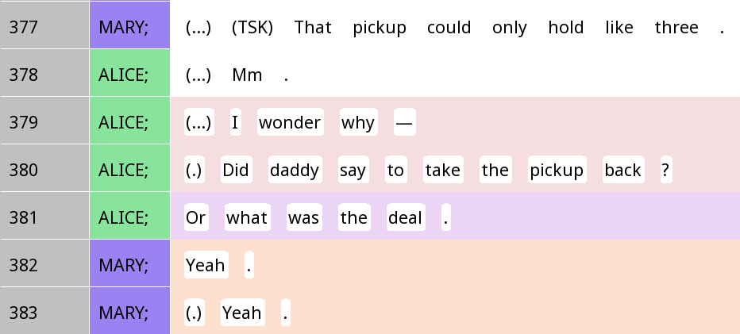
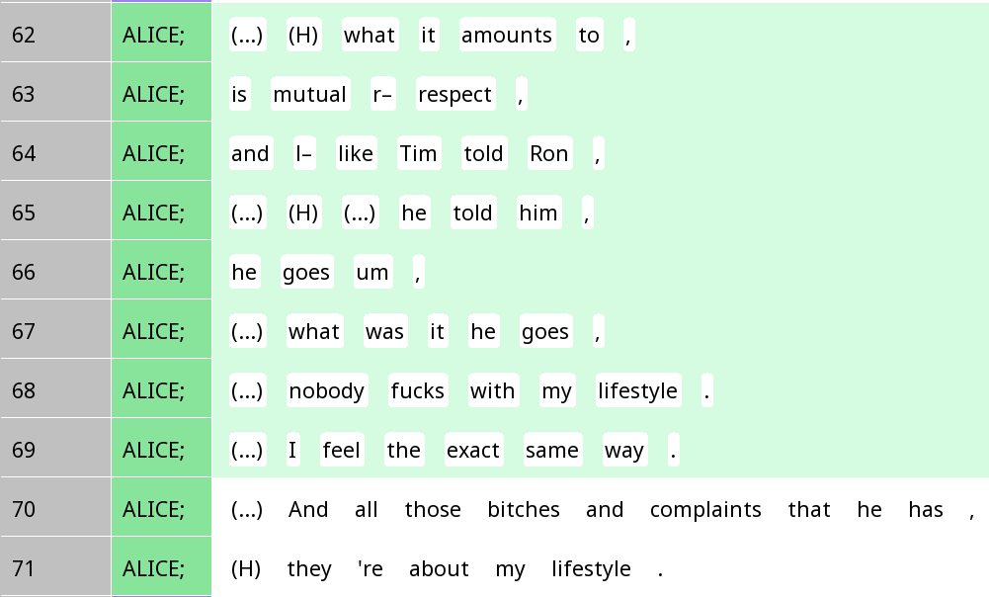
Epistemic access as a pragmatic cue for recognising actions

Slide 29
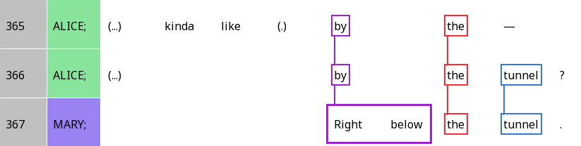
Resonance and epistemic authority
 | A | B | C-E |  |  | F
Alice | (Alice) | kinda like | by | the | tunnel | ? (seeking confirmation)
Mary | (Mary) | (higher authority) | right below | the | tunnel | . (reserved agreement)

Slide 30
Epistemic gradients
Do you think Alice is characterising herself as having higher epistemic authority on line 379 and 381, or on line 380?

Slide 31
Epistemic gradients
Alice: K-
Mary: K+
Yeah.
Did daddy say to take the pickup back?
What was the deal?

Slide 32
Assessments
When you give your value judgements about something: Saying it’s good or bad, beautiful or ugly …
We’ll talk more about this next week
For now, we focus on epistemic access in assessments

Slide 33
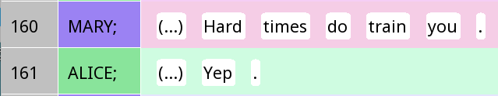
Leads and follows
Stance lead
Stance follow
Question: Who generally has higher epistemic access, the leader or the follower?

Slide 34
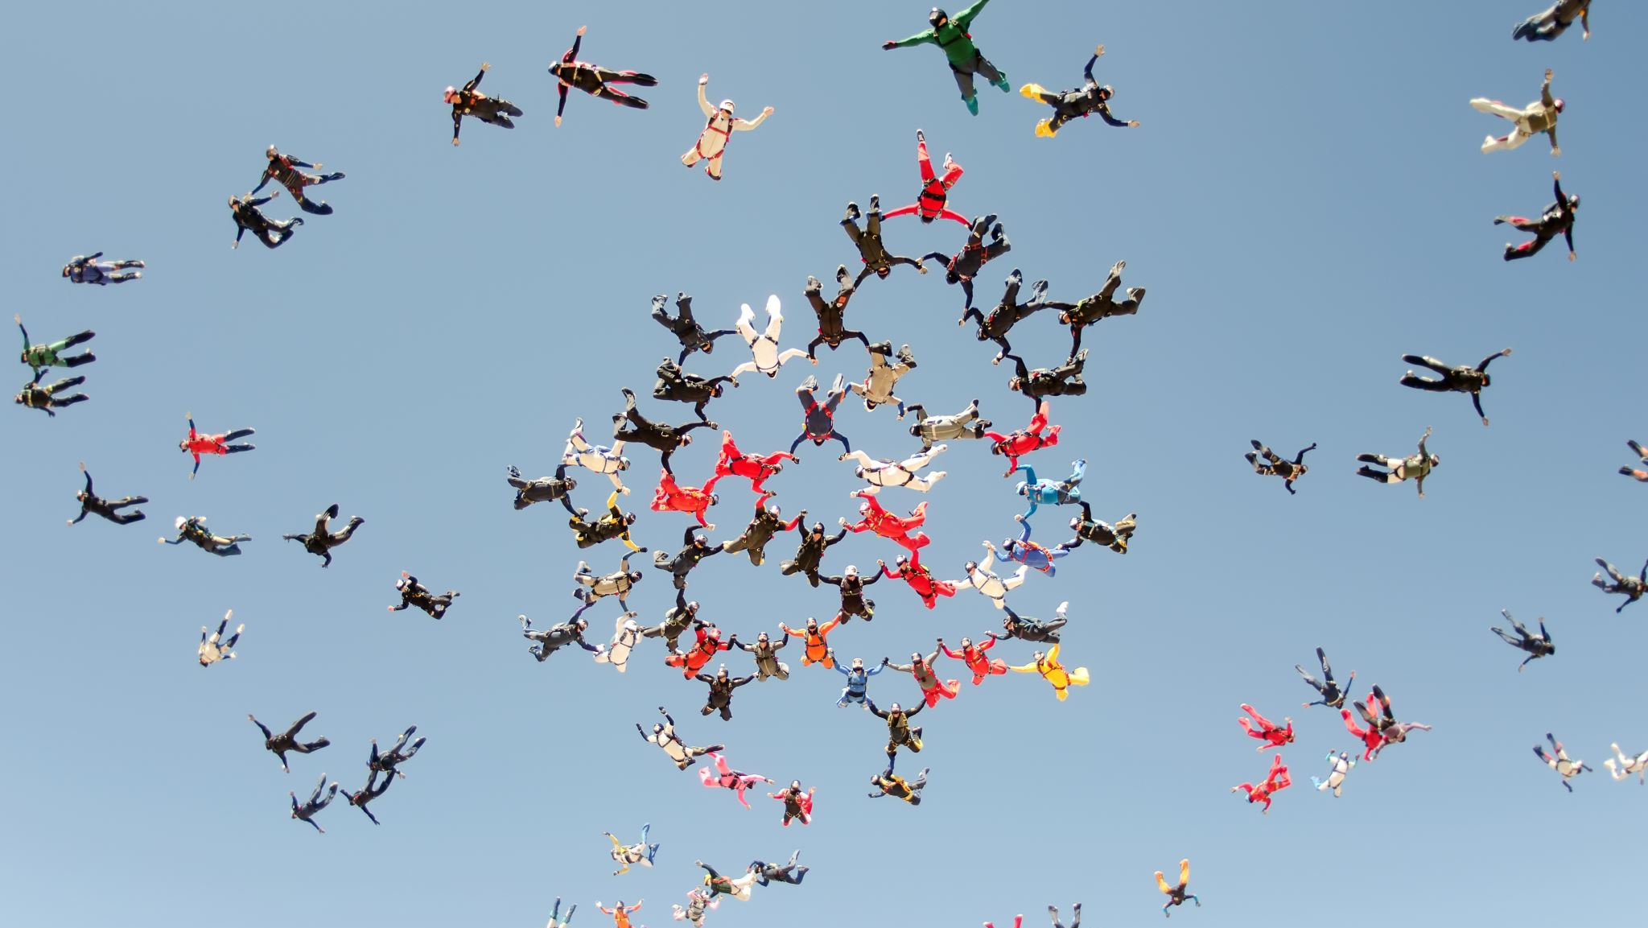
Generally…
The person who provides the first assessment (first pair part) has higher epistemic authority (K+)
The person who provides the second assessment (second pair part) has lower epistemic authority (K-)
But speakers have all sorts of ways to get out of this general pattern
Epistemic upgrading: I know more than you might expect of my position
Epistemic downgrading: I know less than you might expect of my position

Slide 35
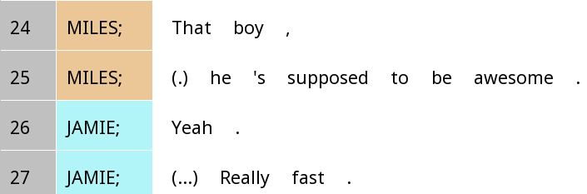
First position epistemic downgrade
‘Supposed to’: Positioning himself as having less epistemic authority, getting that idea from other sources

Slide 36
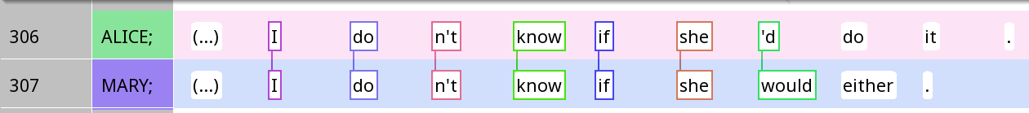
Second position epistemic upgrade: Resonance
If Mary had just said, ‘Right.’, or ‘True.’, how would Mary’s expressed level of epistemic authority change?

Slide 37
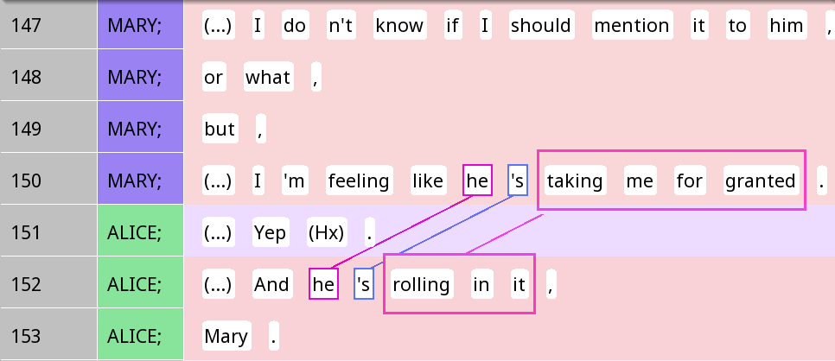
Second position epistemic upgrade: Elaborating on a ‘yeah’

Slide 38

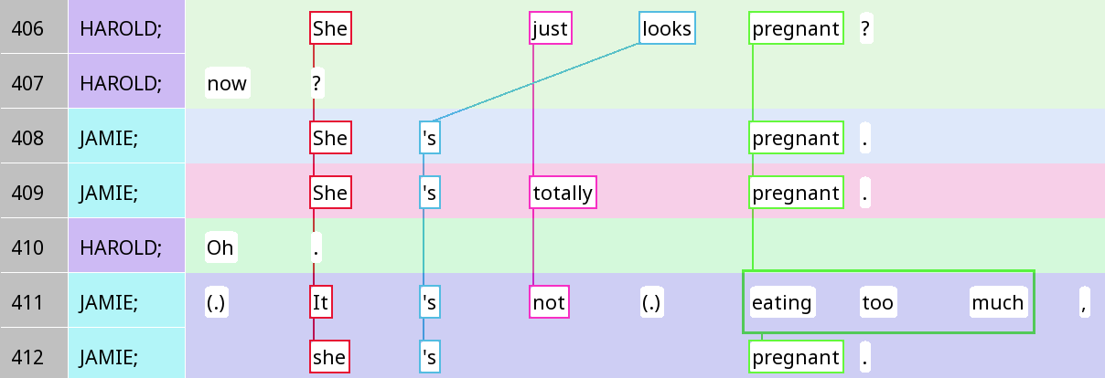



What is all the linguistic evidence for epistemic access here?

Slide 39
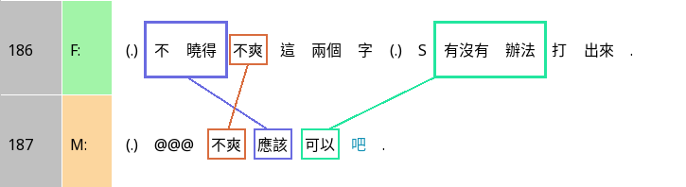
Epistemic downgrade in Chinese: 吧 ba
I don’t know if the words ‘not cool’ can be typed out.
‘Not cool’ should be fine ba.
How does F downgrade her epistemic access?
How does M respond to that?

Slide 40
Positions and upgrade/downgrade (from Heritage and Raymond)
 | First position | Second position
Downgrade | Words like 'seems', 'sounds', 'appears', 'looks’ … that name a source for the info ‘I think’ … Tag questions 'isn't it?', 'right?
Unmarked (‘normal’) | Simple declarative sentence (It’s nice.) | Simple declarative, e.g. ‘Sure is.’ A short response like ‘yeah’
Upgrade | Negative questions ‘Isn’t that nice?’ | Confirmation + Agreement ‘It is, yeah’ Oh-prefacing ‘Oh that’s nice’ Tag questions 'isn't it?', 'right?’ Negative questions ‘Isn’t that nice?’

